Slide 1
Attachment Bits

Slide 2
4.1.3 Attachment
Caregiver-infant interactions in humans: reciprocity and interactional synchrony. Stages of attachment identified by Schaffer. Multiple attachments and the role of the father.
Animal studies of attachment: Lorenz and Harlow.
Explanations of attachment: learning theory and Bowlby’s monotropic theory. The concepts of a critical period and an internal working model.
Ainsworth’s ‘Strange Situation’. Types of attachment: secure, insecure-avoidant and insecure resistant.
Cultural variations in attachment, including van Ijzendoorn.
Bowlby’s theory of maternal deprivation. Romanian orphan studies: effects of institutionalisation.
The influence of early attachment on childhood and adult relationships, including the role of an internal working model.

Slide 3
internal working model
The child’s attachment relationship with their primary caregiver leads to the development of an internal working model (Bowlby, 1969).

Slide 4
internal working model
This internal working model is a cognitive framework comprising mental representations for understanding the world, self and others. A person’s interaction with others is guided by memories and expectations from their internal model which influence and help evaluate their contact with others (Bretherton, & Munholland, 1999).

Slide 5
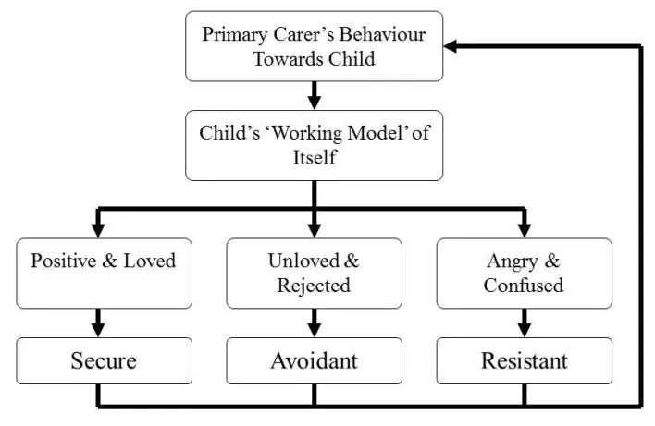

Slide 6
Influence of early attachment on childhood and adult relationships.
Bowlby presented the concept of the internal working model. He hypothesised that later relationships are likely to be a continuation of early attachment style (secure or insecure). This is because the infant’s primary caregiver promotes a model of relationships, this leads the infant to expecting the same in later relationships, e.g. love and care. In some extreme cases, an infant’s internal working model can lead them to develop an attachment disorder.

Slide 7
Simpson 2007
Described the 'lasting legacy of love', conducting a longitudinal study for almost 30 years. 78 participants were assessed at infancy, childhood, adolescence and adulthood. At age 6-8, caregivers rated the child's interactions, at 16 the participants themselves described their close relationships and at adulthood, participants' partners described their relationships. Securely attached infants grew up to have greater social competence at age 6-8. These same children then had closer relationships at age 16, then went on to be more emotionally attached to their romantic partners in adulthood.

Slide 8
Hazan & Shaver 1987
Secure childhood attachments lead to happier, longer-lasting adult relationships. Individuals who were insecurely attached as infants are less comfortable in adult relationships, finding it harder to depend and be depended upon.
Only USA study

Slide 9
Qualter & Munn 2005
Studied peer relations, suggesting that a child's internal model is also developed through interactions with their peers. The experiences of such interactions are internalised - these internal expectations then affect how the individual sees themselves and approaches adult relationships.

Slide 10
Conclusion
The influence of childhood on adult relationships can be seen to be deterministic as it says that our childhood has a fixed effect on our adult relationship, however this is not the case as we have free will to choose how we act in later relationships and whether or not to let these experiences lead us. Also social learning theory would say that we learn though observing other which in this case could be seeing relationships completely different to those we have experienced before and copying those instead of building on our own bad experiences.

Slide 11
Caregiver-infant interactions in humans: reciprocity and interactional synchrony. Stages of attachment identified by Schaffer. Multiple attachments and the role of the father.

Slide 12
Reciprocity and interactional synchrony.
The concepts in this area are describing the metaphorical dance between infant and caregiver. It looks, feels and acts like a conversation between infant and caregiver. Though no words may be uttered (not on the baby’s part anyway) this two-way interaction has two active contributors. The interactions will be rhythmic and mutual; infant and caregiver are likely to appear to be in harmony as they take turns in this attachment promoting conversation which is likely to involve the infant and caregiver responding to each other with similar sounds, emotions and behaviours. Infant and caregiver are able to anticipate how each other will behave and can elicit a particular response from the other.
What does it look like? The caregiver who smiles at their baby in response to a smile-like facial movement from the infant or who opens their mouth in mock surprise when the infant scrunches up their face, is engaged in this two-way pattern of interaction and is laying the foundations for an attachment to form. The infant that cries and elicits a sad expression and look of upset on their caregivers face or the caregiver who laughs in response to their infants giggling sound and tickles them, is experiencing synchronised interaction.

Slide 13
Reciprocity
The word reciprocal means two-way, or something that is mutual. Infant and caregiver are both active contributors in the interaction and are responding to each other. This is referred to as reciprocity.

Slide 14
Interactional synchrony
The word synchrony means a simultaneous action or occurrence. Interactional synchrony relates to the timing and pattern of the interaction. The interaction is rhythmic and can include infant and caregiver mirroring each other’s behaviour and emotion. The infant and caregiver’s behaviours and affect are synchronised because they are moving in the same, or a similar, pattern.

Slide 15
Research
Condon and Sander (1974) have investigated interactions between infants and caregivers in particular in relation to responses to adult speech. In their paper they report “As early as the first day of life, the human neonate moves in precise and sustained segments of movement that are synchronous with the articulated structure of adult speech”.
According to research by Meltzoff and Moore (1983) infants as young as 3 days imitate the facial expression of adults. This implies that this ability to mirror is an innate behaviour.

Slide 16
Stages of Attachment
Rudolph Schaffer and Peggy Emerson (1964) studied 60 babies at monthly intervals for the first 18 months of life (this is known as a longitudinal study).

Slide 17
The children were all studied in their own home and a regular pattern was identified in the development of attachment. The babies were visited monthly for approximately one year, their interactions with their carers were observed, and carers were interviewed. Evidence for the development of an attachment was that the baby showed separation anxiety after a carer left.

Slide 18
They discovered that baby's attachments develop in the following sequence:
Up to 3 Months Indiscriminate attachments. The newborn is predisposed to attach to any human. Most babies respond equally to any caregiver.
After 4 months - Preference for certain people. Infants they learn to distinguish primary and secondary caregivers, but accept care from anyone.
After 7 months - Special preference for a single attachment figure. The baby looks to particular people for security, comfort and protection. It shows fear of strangers (stranger fear) and unhappiness when separated from a special person (separation anxiety). Some babies show stranger fear and separation anxiety much more frequently and intensely than others, but nevertheless they are seen as evidence that the baby has formed an attachment. This has usually developed by one year of age.
After 9 months - Multiple attachments. The baby becomes increasingly independent and forms several attachments.

Slide 19
The 4 stages outlined by Schaffer and Emerson are outlined here:
Asocial stage:
This is usually up to 6 weeks of age. The will usually form attachments with any human. Despite not having a bias to a particular human it is often seen that they prefer human like stimuli (e.g. Dolls) This was observed by Schaffer and Emerson when they approached the infant and it responded as it would with anyone.
Indiscriminate attachment:
This is usually 6 weeks to 6 months. Babies become more “sociable”. They can tell people apart and so begin to form stronger attachments however these do not progress much until the next stage. At this stage, Schaffer and Emerson found that they did not show a fear of strangers.
Specific attachment:
Usually 7 months onward. The key things about this stage are that the infant begins to show separation anxiety and “protests”, usually by crying, when their primary attachment figure leaves. The second key behaviour is that they begin to show fear of strangers.
Multiple Attachments:
10-11 months onwards. The infant begins to make make multiple attachments. This is usually towards friends, grandparents and childminders/ nursery staff.

Slide 20
The results of the study indicated that attachments were most likely to form with those who responded accurately to the baby's signals, not the person they spent more time with. Schaffer and Emerson called this sensitive responsiveness.
Many of the babies had several attachments by 10 months old, including attachments to mothers, fathers, grandparents, siblings and neighbors. The mother was the main attachment figure for about half of the children at 18 months old and the father for most of the others. The most important fact in forming attachments is not who feeds and changes the child but who plays and communicates with him or her.

Slide 21
Multiple attachments and the role of the father.

Slide 22
Bowlby (1988)
Reasoned that if patterns of attachment are a product of how their mother has treated them, it could be anticipated that the pattern he develops with his father is the product of how their father has treated them. Bowlby suggests that fathers can fill a role closely resembling that filled by a mother but points out that in most cultures this is uncommon. Bowlby argues that in most families with young children, the father's role tends to be different. According to Bowlby, a father is more likely to engage in physically active and novel play than the mother and tends to become his child's preferred play companion.

Slide 23
Schaffer & Emerson
Found that additional attachments developed in the proceeding months following the 4thstage, observing 31% of infants displaying 5 or more attachments by 18 months.
We have seen this previously

Slide 24
Grossman’s (2002)
Conducted a longitudinal study of 44 families comparing the role of fathers’ & mothers’ contribution to their children's attachment experiences at 6, 10 and 16 years. Fathers’ play style (whether it was sensitive, challenging and interactive) was closely linked to the fathers’ own internal working model of attachment. Play sensitivity was a better predictor of the child's long-term attachment representation than the early measures of the of attachment type that the infant had with their father.

Slide 25
Field (1978)
Conducted research which compared the behaviours of primary caretaker mothers with primary and secondary caretaker fathers. Face-to-face interactions were analysed from video footage with infants at 4 months of age. Overall, it was observed that fathers engaged more in game playing and held their infants less. However, primary caretaker fathers engaged in significantly more smiling, imitative grimaces, and imitative vocalizations than did secondary caretaker fathers and these were comparable with mothers’ behaviour.

Slide 26
Brown et al. (2012)
Investigated father involvement, paternal sensitivity, and father−child attachment security at 13 months and 3 years of age. Results demonstrated that involvement and sensitivity influenced father−child attachment security at age 3. Involvement was a greater predictor of secure attachment when fathers were rated as less sensitive.
The research from Brown and Field indicates that the gender of a caregiver is not crucial in predicting attachment types/ quality, rather it is the extent of caregiver involvement.

Slide 27
Therefore what?

